Slide 1
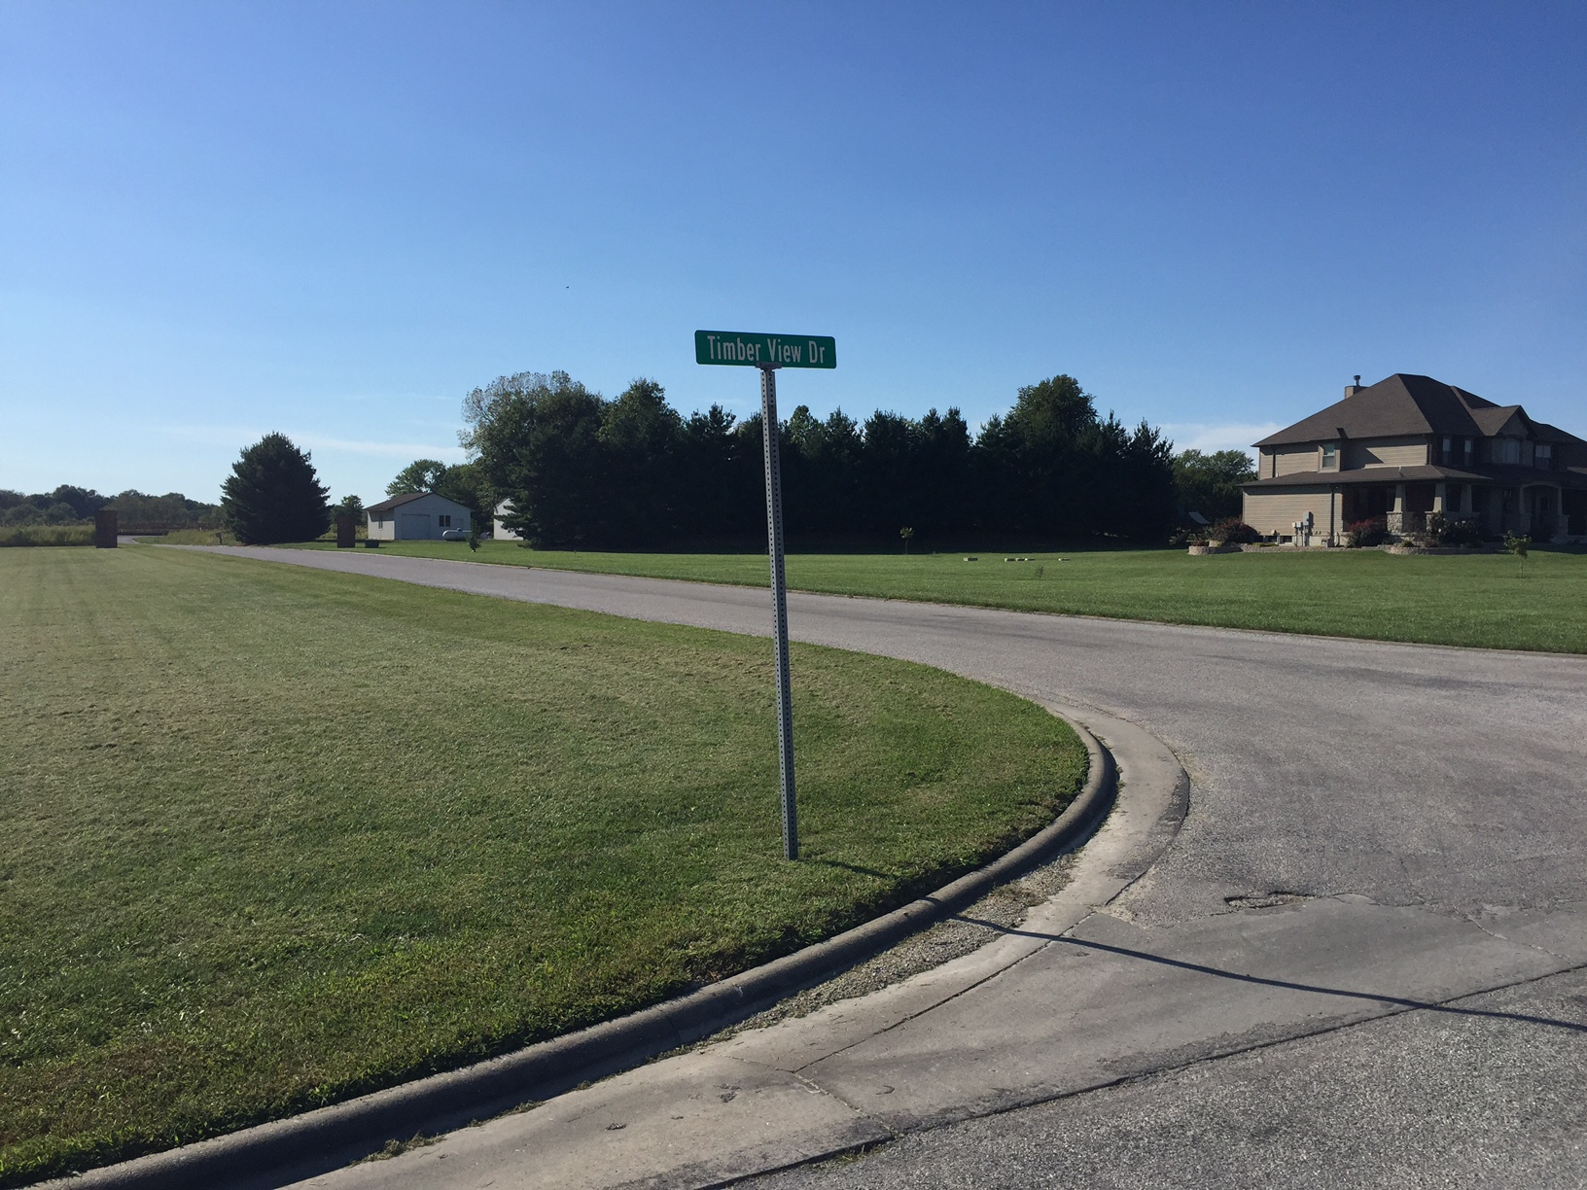
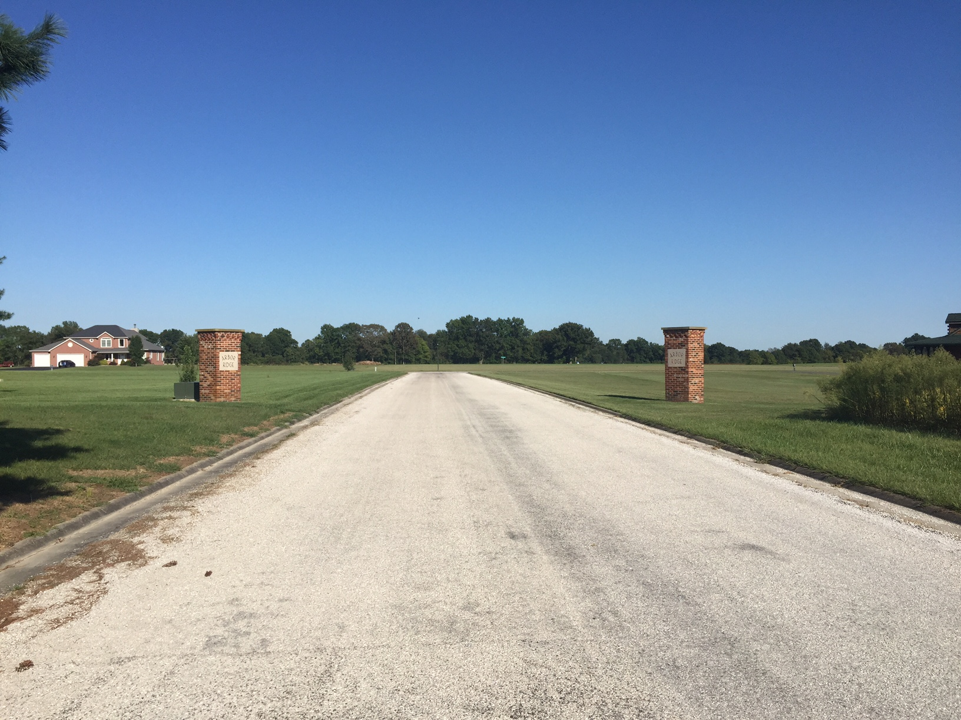
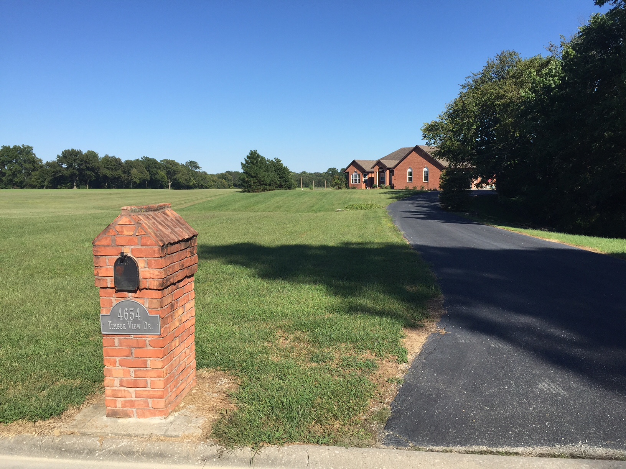
Arbor Ridge Estates
Donielle Grimsley NRES 598 Fall 2016

Slide 2
General Characteristics
Our Neighborhood Consists of:
13 3-acre lots
11 single family homes
2 oil & chip streets maintained by St Clair County
Arbor Ridge Drive
Entrance and exit to the neighborhood
0.2 miles long
No homes
Timber View Drive
0.3 miles long
A double sided “lollipop”
A small privately owned lake

Slide 3
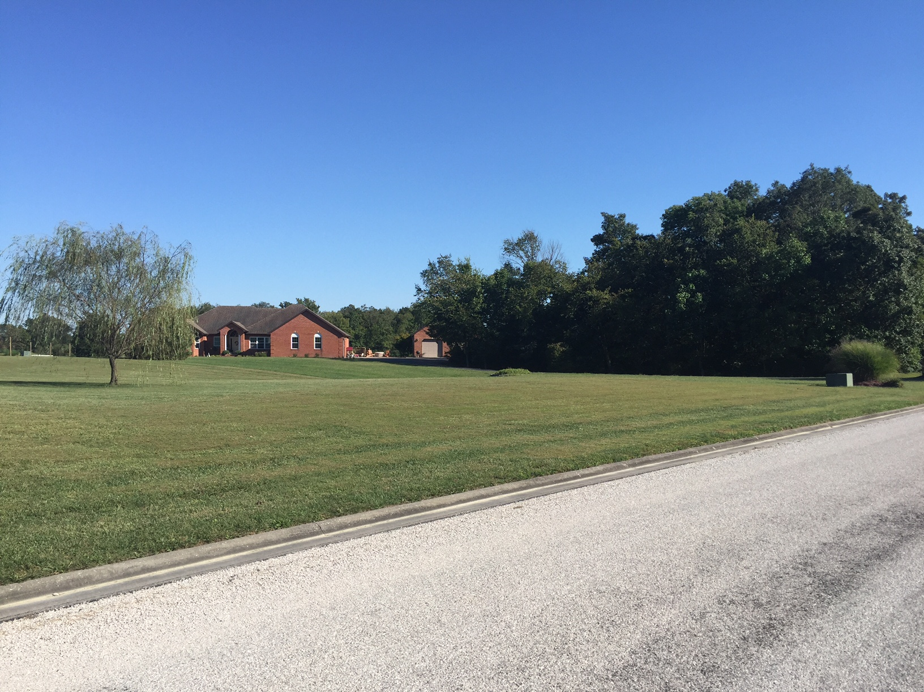
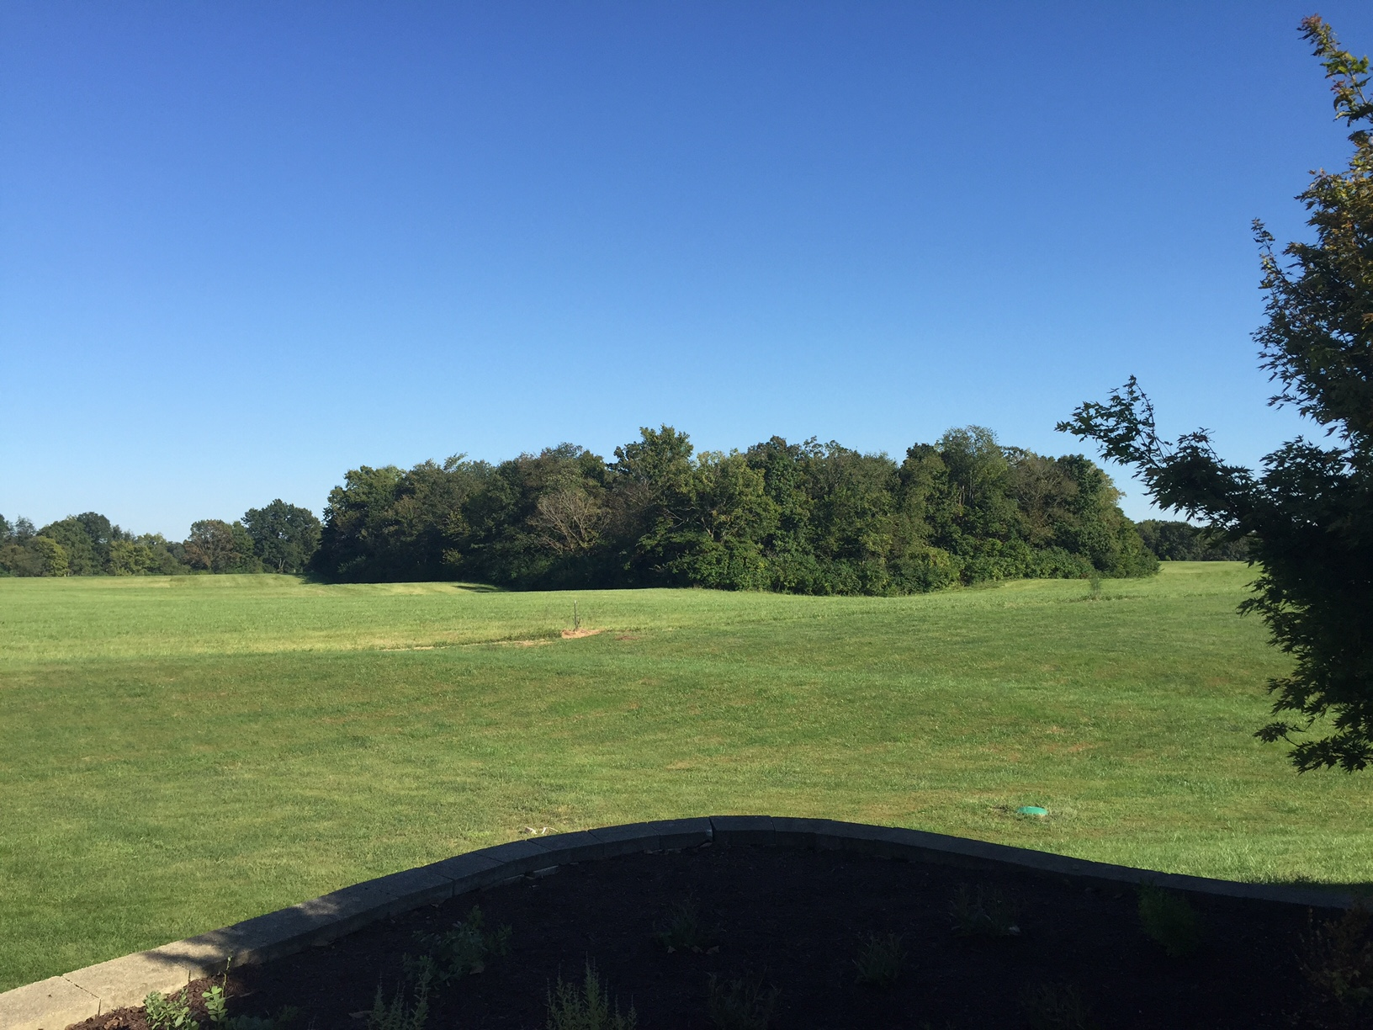
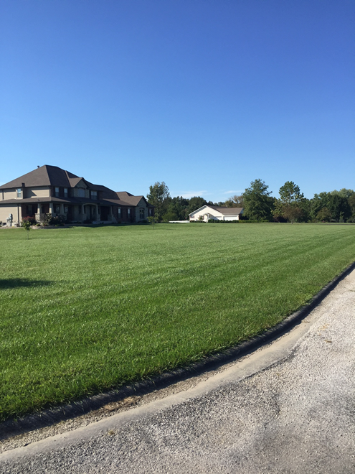
Neighborhood Restrictions
Single-family residences used for no other purpose
Existing homes were built between 1995 and 2014
One-story residence minimum of 1800 square feet; two-story minimum of 2300 square feet
No loud, noxious, or offensive activities
All vehicles stored in closed garages
Grass must be mowed and kept no higher than 6 inches
No above-ground swimming pools
Prior approval by developer for any building or structure

Slide 4
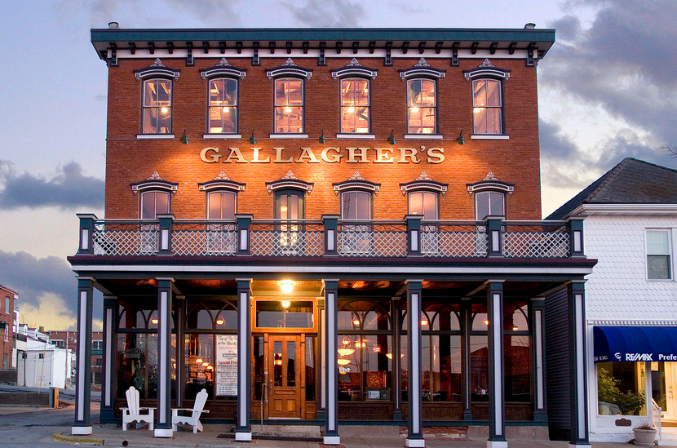
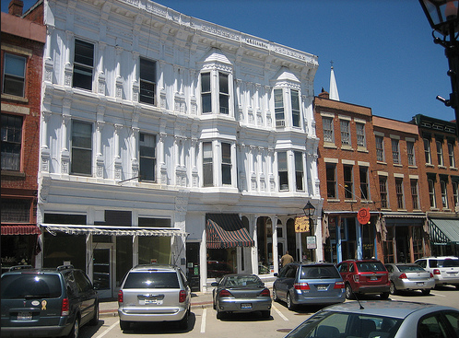
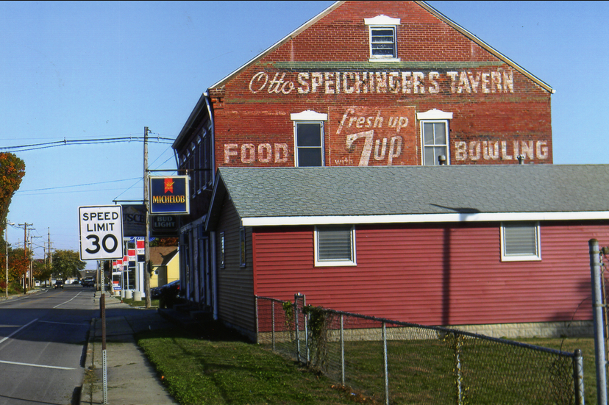
Surrounding Area
Floraville, IL
Approximately 4 miles away
Population: 53
2 Churches and a Bar (Paderborn; population: 43)
Waterloo, IL
Approximately 5 miles away
Population: 10,000
Mom & Pop restaurants and stores downtown
Wal-Mart, Applebees, Grocery, chain stores on outskirts
Millstadt, IL
Approximately 5 miles away
Population: 4,000
Mom & Pop stores and restaurants
St Louis, Missouri
Approximately 20 miles away
Major sports teams, shopping, restaurants, hotels, etc.

Slide 6
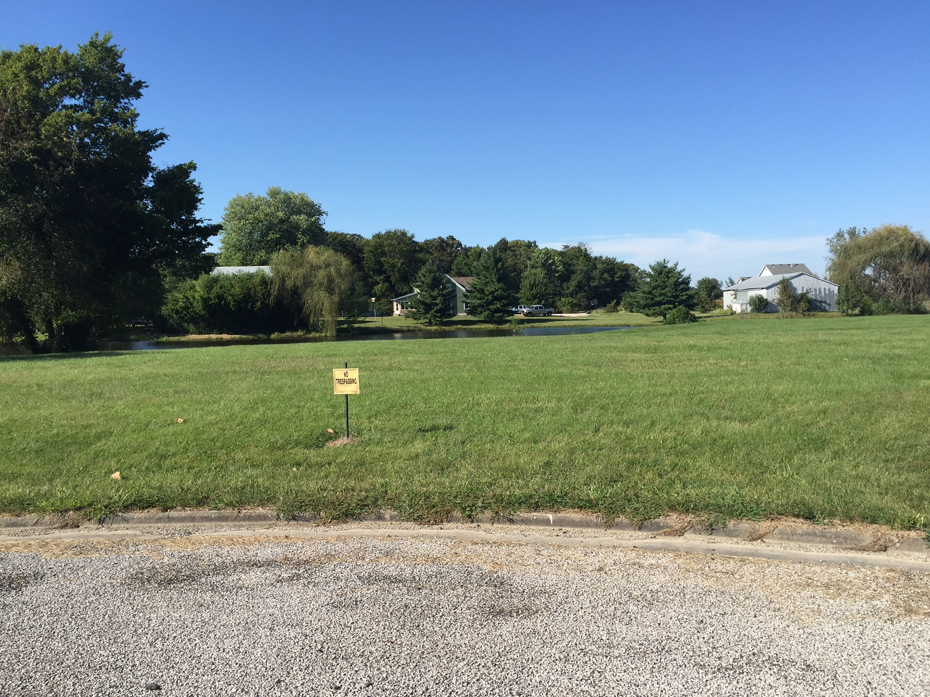
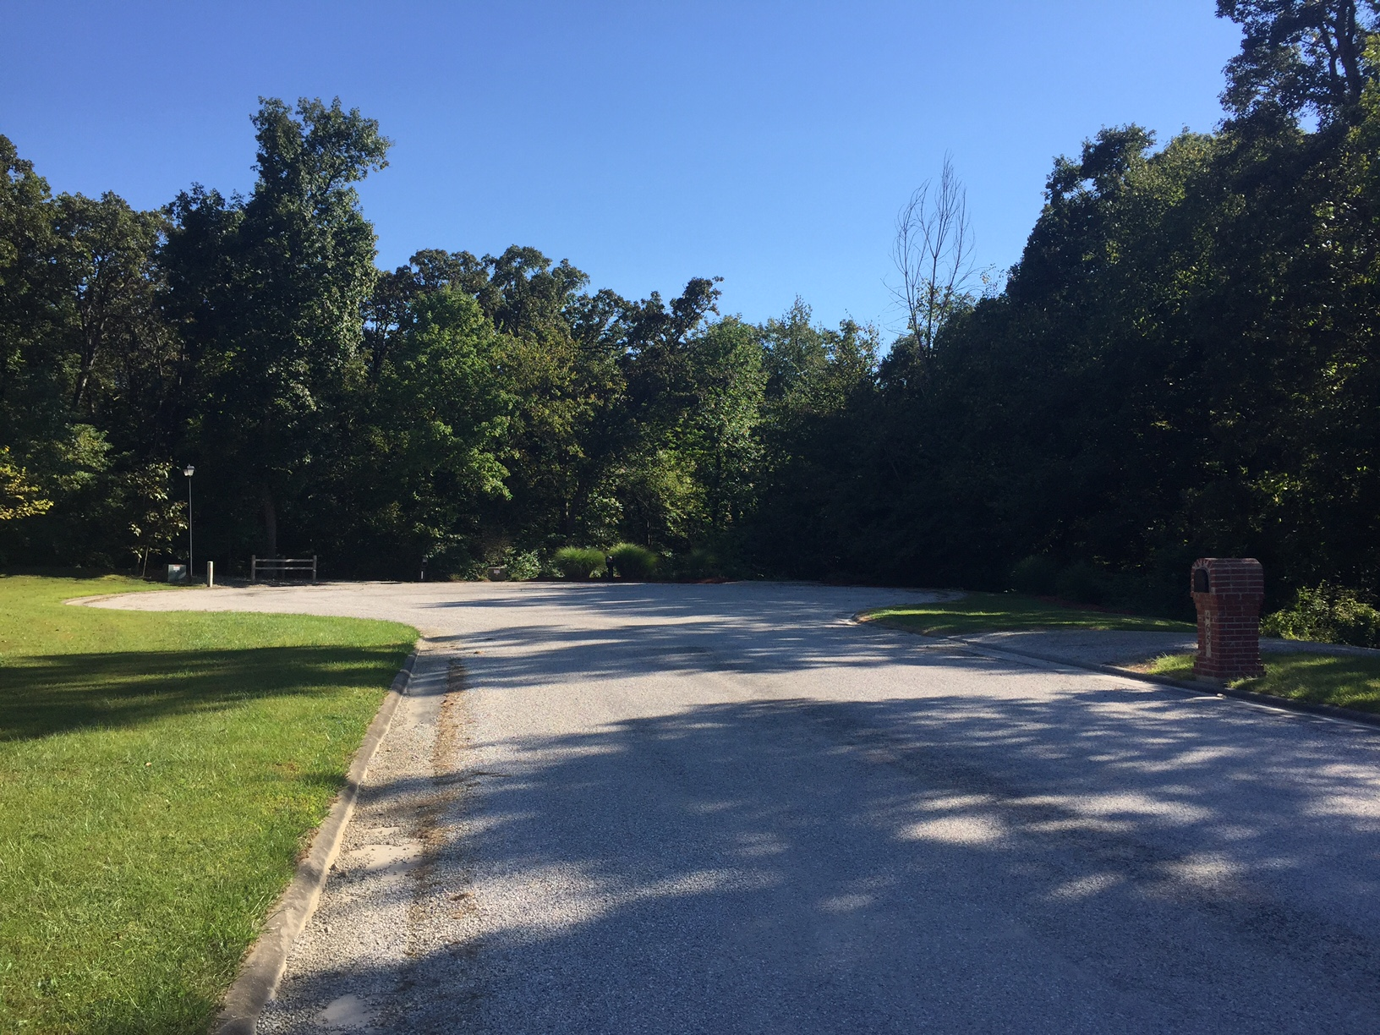
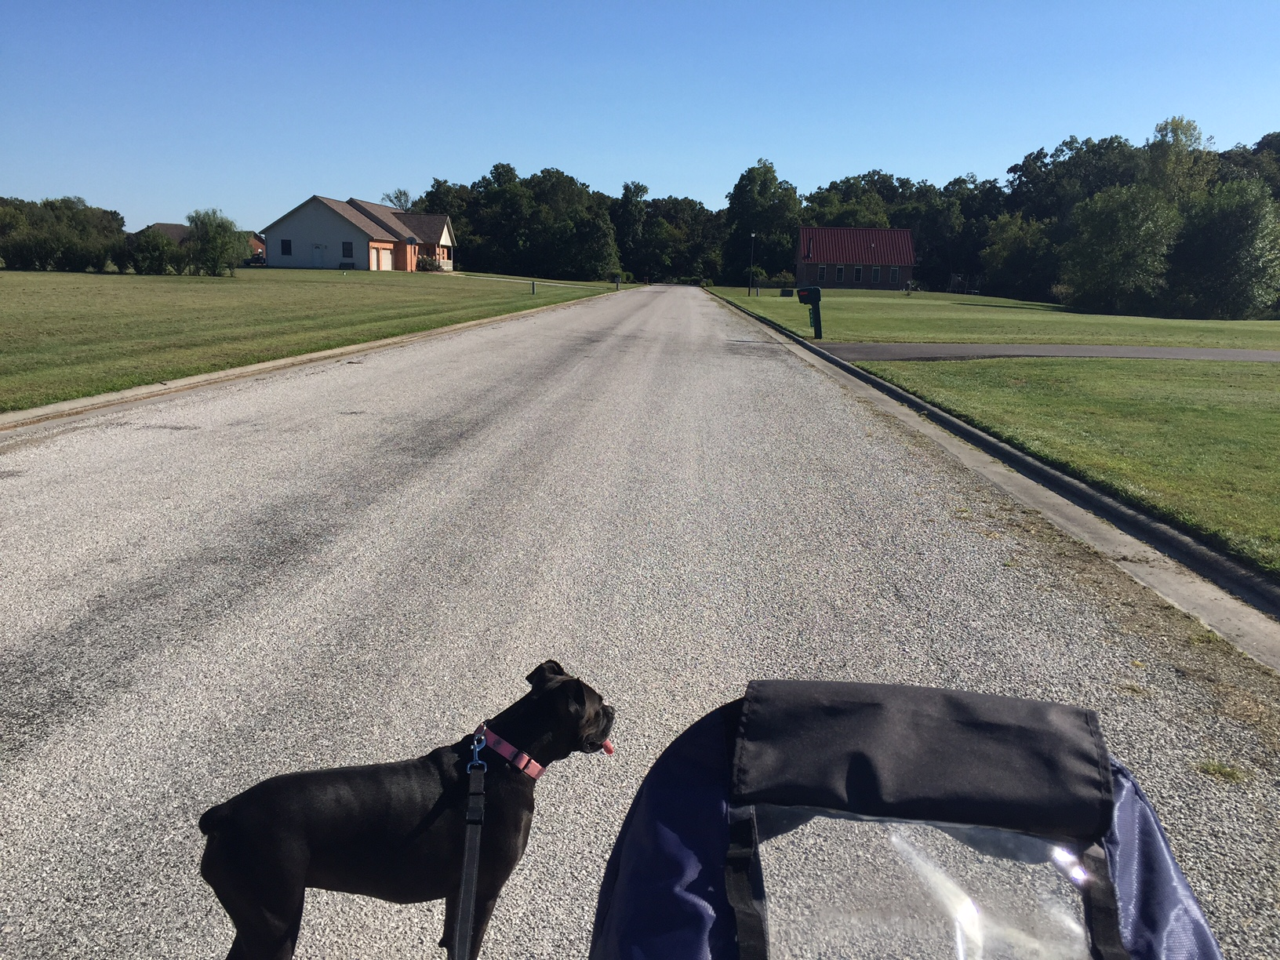
Our Rural Neighborhood
Most homes are set back from street which makes communication with neighbors difficult
3 homes in cul-de-sac are entirely surrounded by woods
One small privately owned lake
Pedestrian friendly within neighborhood despite lack of sidewalks
Arterial streets are winding and not pedestrian friendly
No sidewalks
No posted speed limits

Slide 7
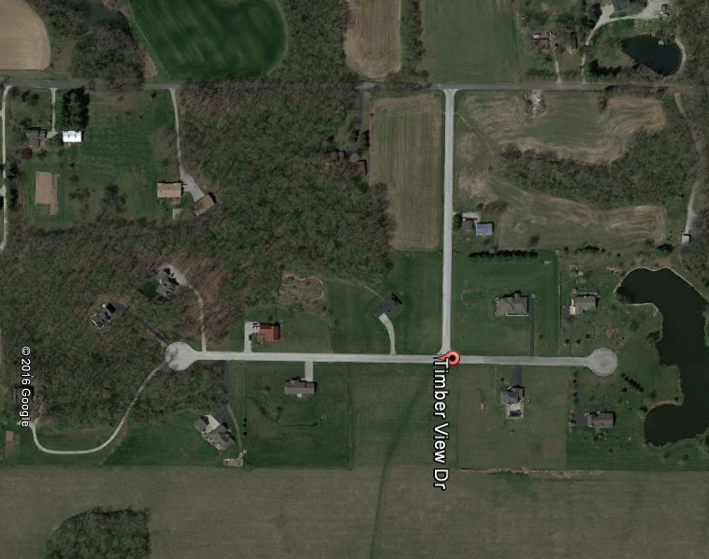

Slide 8
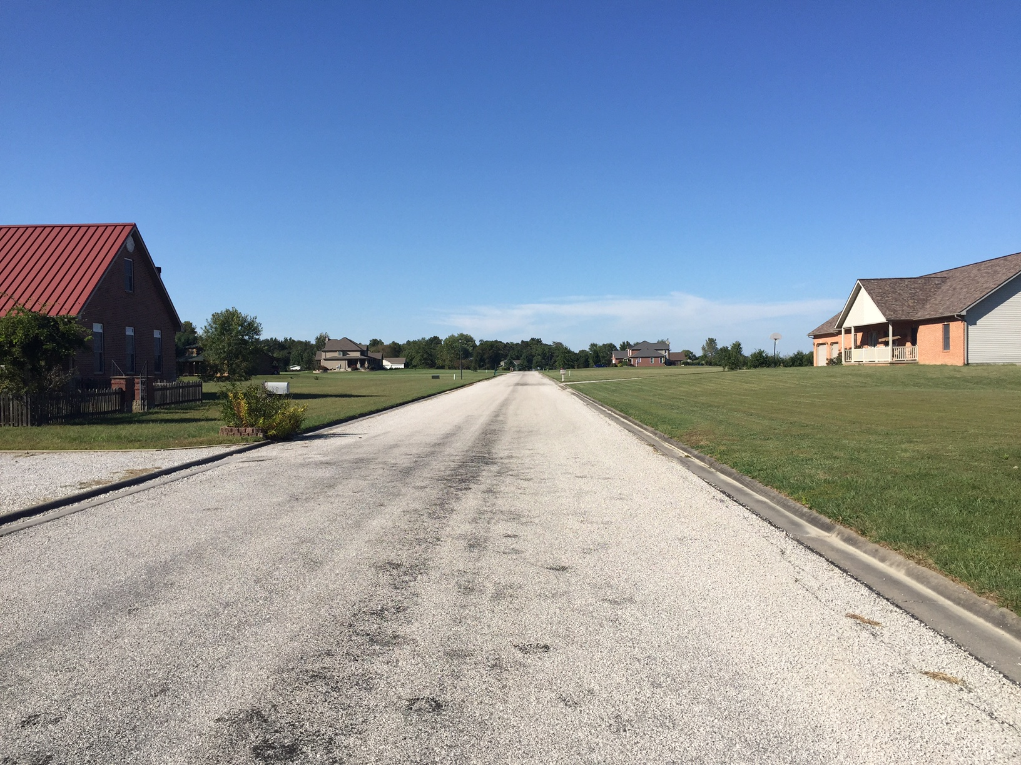
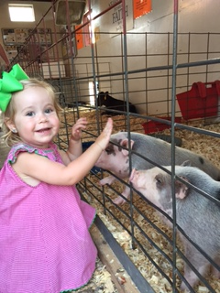
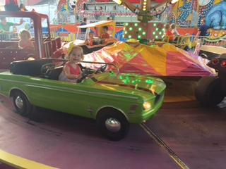
Neighborhood Dynamics
Middle to Upper-Middle Class White Families
Waterloo racial make-up is 98.8% white
Age ranges: mid-30’s to mid-70’s
3 families with young children
3 families with high-school age children
Lawsuit regarding agricultural use of central lot has essentially divided the residents of the neighborhood
Some interaction takes place in the neighborhood
Waving
Small-talk while passing on streets
Interaction takes place outside of neighborhood at festivals/stores/restaurants

Slide 9
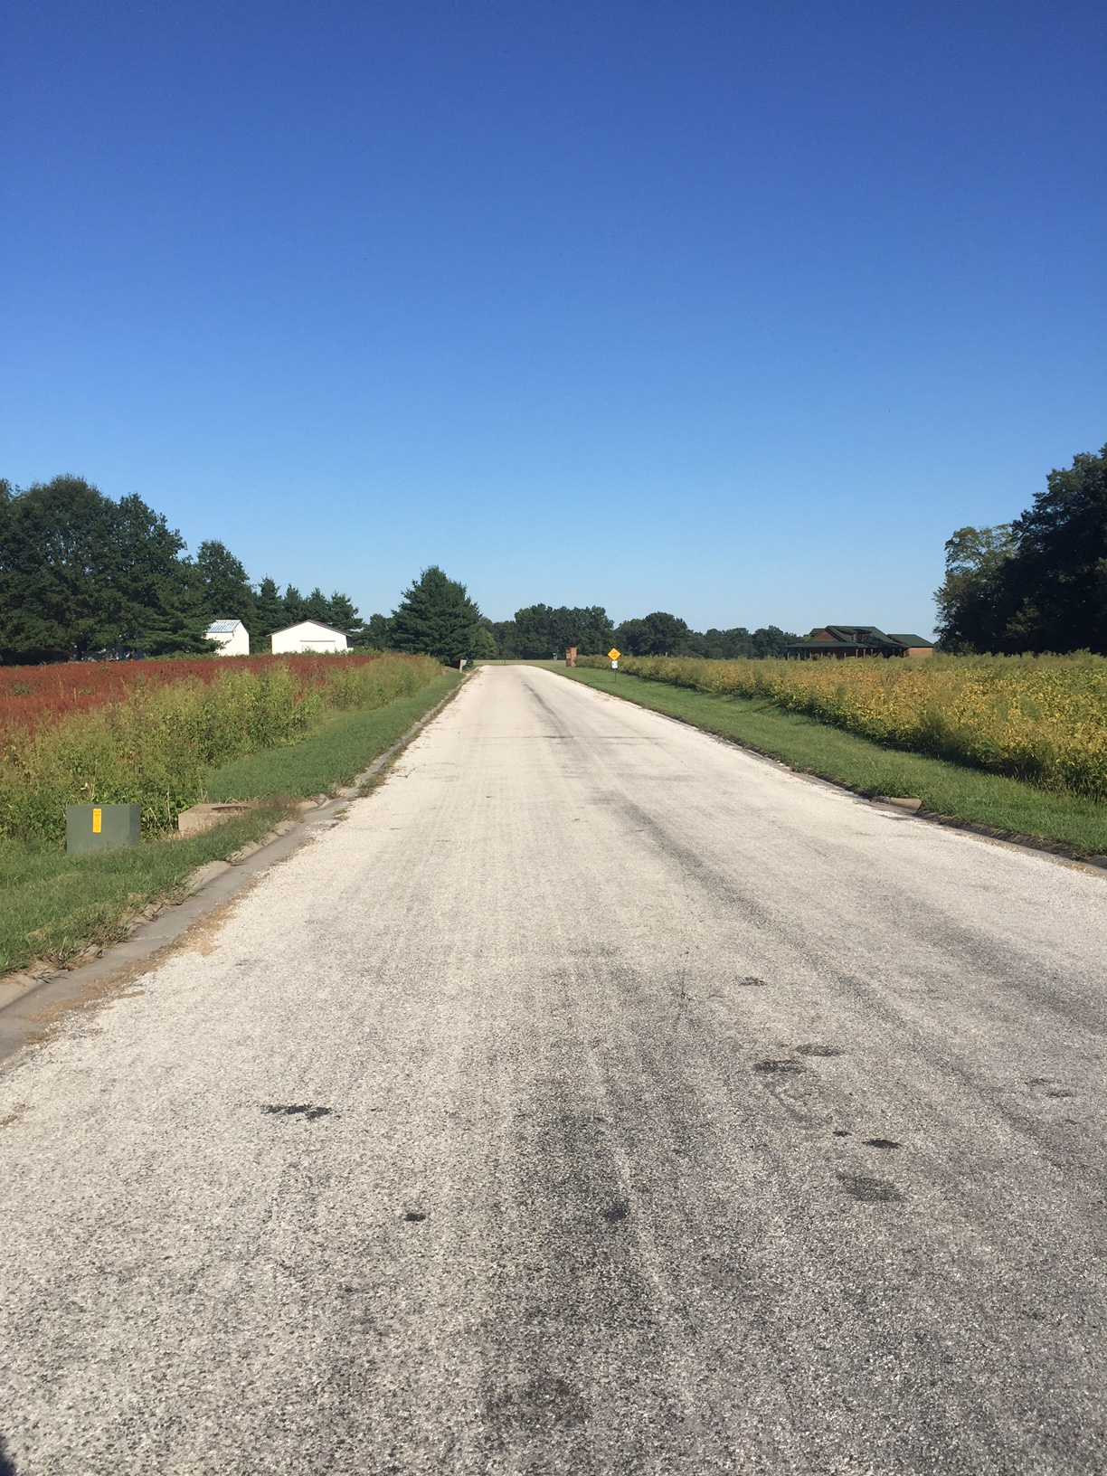
Neighbor Opinions
Those interviewed enjoy the peace and quiet and open space
Distance to services and time spent on upkeep/maintenance is small price to pay for open space
Those with young children (including myself) are concerned regarding children growing up with few neighborhood friends and lack of walkability to schools/parks/playgrounds

Slide 10
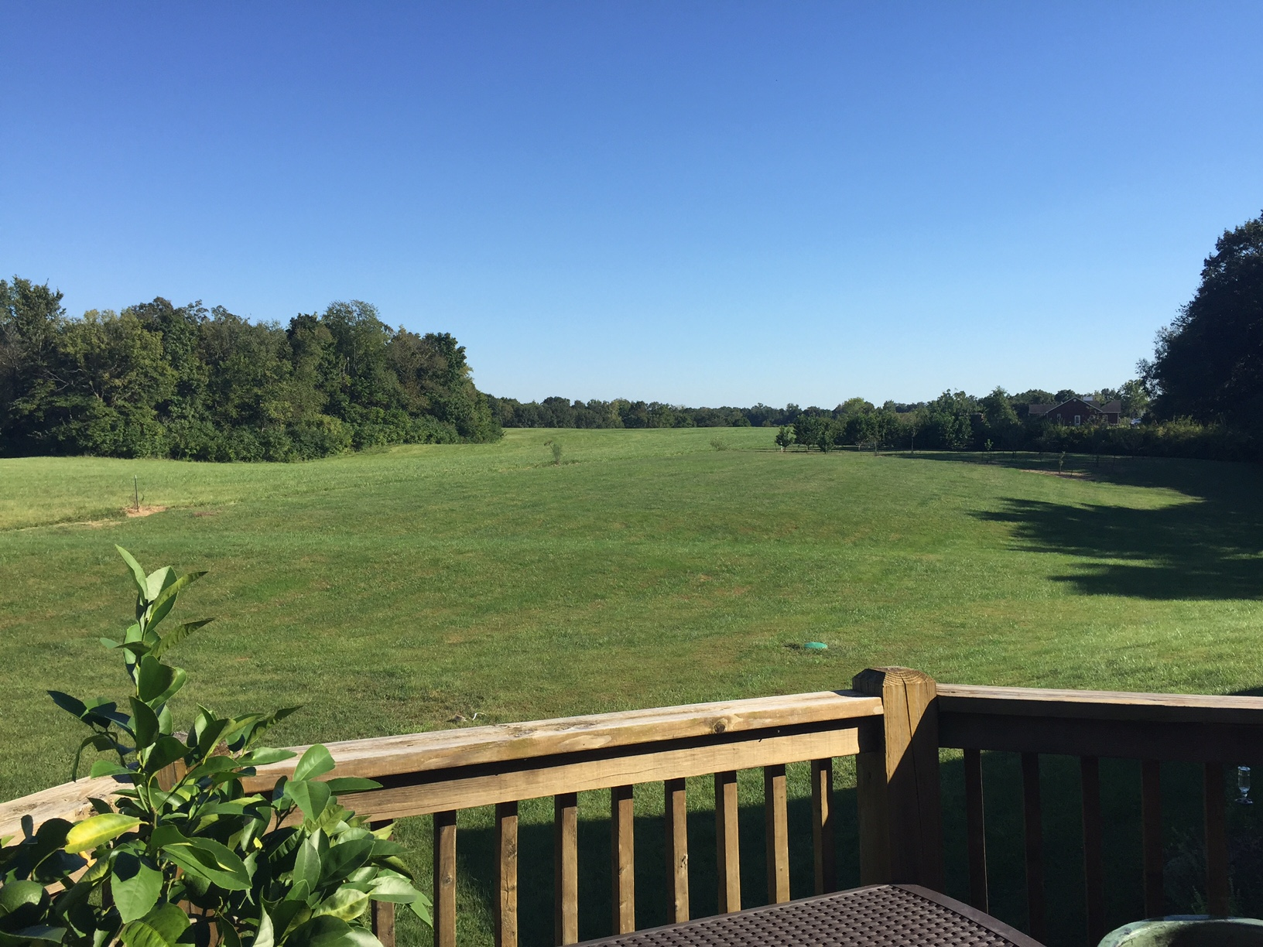
Questions?

